Slide 1



Twitter Bug Hunt
@avicoder

Slide 2


FTW I am -
Avinash
Senior Security Researcher @ Paladion Networks
Bounty Hunter @avicoder (hackerone)
Programmer @vjex (github)
Blogger (avicoder.me)

Slide 3

Agenda
Bounty
Repeat
Bug

Slide 4



0x01 Open Redirection
Fabric : Mobile App Analytics platform
It’s a ruby application
Proper routes for each endpoints are created by developer
After successful login, page goes redirected to https://www.fabric.io/login?redirect_url=/dashborad

Slide 5
0x01 Open Redirection
On changing https://www.fabric.io/login?redirect_url=/dashborad to https://www.fabric.io/login?redirect_url=/google.com
Page is routed to
https://www.fabric.io/google.com
and ultimately to 302

Slide 6

0x01 Open Redirection
What about “@“ ?
All browser treat the value before @ as username and the domain is specified after it.
How can we use this for exploitation?
Lets check- >
avicoder@google.com
So when we send
https://www.fabric.io/login?redirect_url=@google.com
The response come to browser is:
https://www.fabric.io@avicoder.me
Which ultimately redirect to
https://avicoder.me ☺
$280

Slide 7


0x02 Android Webview
CVE-2013-4710
Android Webview Activity uses WebKit rendering engine to display web pages.
A Bug was found by Rafey Baloch in Android Operating system.
Allows hacker to execute arbitrary code execution inside the application sandbox if JavaScript is enabled for Webview activity.
Fixed in Kitkat but devices running jellybean or less are still vulnerable to it.
Both Twitter and Vine Android application were using Webview with JavaScript or File Access enabled.

Slide 8
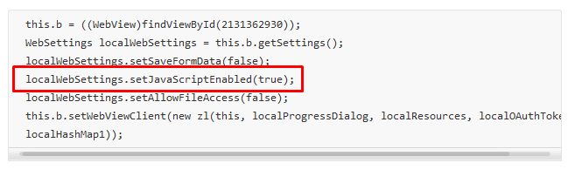
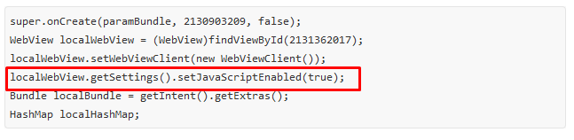
0x02 Android Webview
Twitter
Vine
$140
+
$140

Slide 9
0x03 Hidden Admin Access - IDOR
ADS
Twitter ads allows user to manage their campaign and promoted tweets.
When a request to fetch user campaign is generated from client:
https://ads.twitter.com/accounts_typeahead.json?query=avicoder
By looking at the source code and JSON response reveals a hidden endpoint which doesn’t require any kind of authorization to access information.
https://ads.twitter.com/admin/accounts_typeahead.json?query=microsoft
Information like who maintains the campaign and its ID along with admin access enabled for which user are disclosed

Slide 10
0x03 Hidden Admin Access - IDOR
ADS
---Snip---
"id": "4503599632317440",
"account_id": "4503599632317440",
"account_name": "Avinash",
"created_at": "2014-12-17T12:07:23Z",
"created_at_ts": 1418818043,
"localTimezone": "America/Los_Angeles",
"localTimezoneCutoff": 0,
"localTimezoneDisplayName": "America/Los Angeles",
"localTimezoneOffsetInSeconds": -28800,
"withJustCreditCards": true,
"hasPaymentMethod": false,
"serviceLevel": null,
"hasCampaignForecasting": false,
"hasApiLocationSearch": true,
"url_id": "18ce53xl2bk",
"user_name_info": " &mdash; includes @avicoder",
"users":
---Snip---
$560

Slide 11
0x04 IDOR – Fabric.io
X-CRASHLYTICS-ACCESS-TOKEN is required to access any endpoint
One of the endpoint doesn’t require X-CRASHLYTICS-ACCESS-TOKEN to be set to authenticated user.
https://fabric.io/api/v2/organizations/<Organization_ID>/team_members.json
---snip--- { "name":"Mitchell Porter", "email":"mitchellporter@gmail.com", "id":"539b6b5cb58e833c53004122", "is_activated":true, "is_admin":true }, { "name":"Kori Handy", "email":"kori@founderfox.io", "id":"556c02c96bb16649e2002052", "is_activated":true, "is_admin":false }
---snip---

Slide 12
0x04 IDOR – Fabric.io
Disclosing information like
Organization name
Its members
Their email ids
Admin enabled flag
Etc.
Open -> Need more info -> Not applicable -> Informative-> reopened ->triaged-> resolved - > Get paid ☺
$560

Slide 13
0x05 Insecure Data Storage
Vine Mobile app.
Storing Third party website’s password in clear text in SQLite database.
Affect the user when Facebook is not installed.
Application loads the Facebook login page and ask for login credentials to share OAuth token.
Auto saving of Password was not disabled.

Slide 14
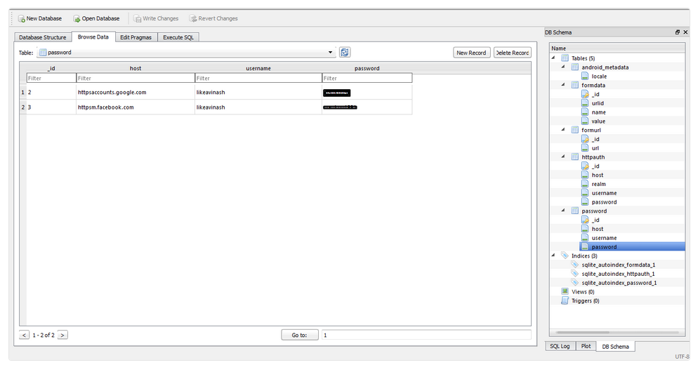
0x05 Insecure Data Storage
$140

Slide 15
0x06 Reflected file Download
Vulnerability was presented by Oren Hafif at BlackHat 2014.
Allows attacker to generate malicious file with extension of his choice dynamically.
Could be exploited by Social engineering techniques.
Impact:
Gain complete control over the user's machine.
Use for sending malicious scripts.
Affect the reputation of vine.
Gain complete control over the Chrome browser including encrypted connections.
Exploit vulnerabilities on installed software.

Slide 16

0x06 Reflected file Download
Show Time ☺

Slide 17
0x07 Reflected file Download
Mitigation :
Use exact URL mapping
Do not escape! Encode!
Add Content-Disposition with a “filename” attribute for APIs.
References:
Hafif RFD Black Hat 2014 - Google Vulnerability
https://www.blackhat.com/docs/eu-14/materials/eu-14-Hafif-Reflected-File-Download-A-New-Web-Attack-Vector.pdf
$ 700 * 4 = $ 2800

Slide 18
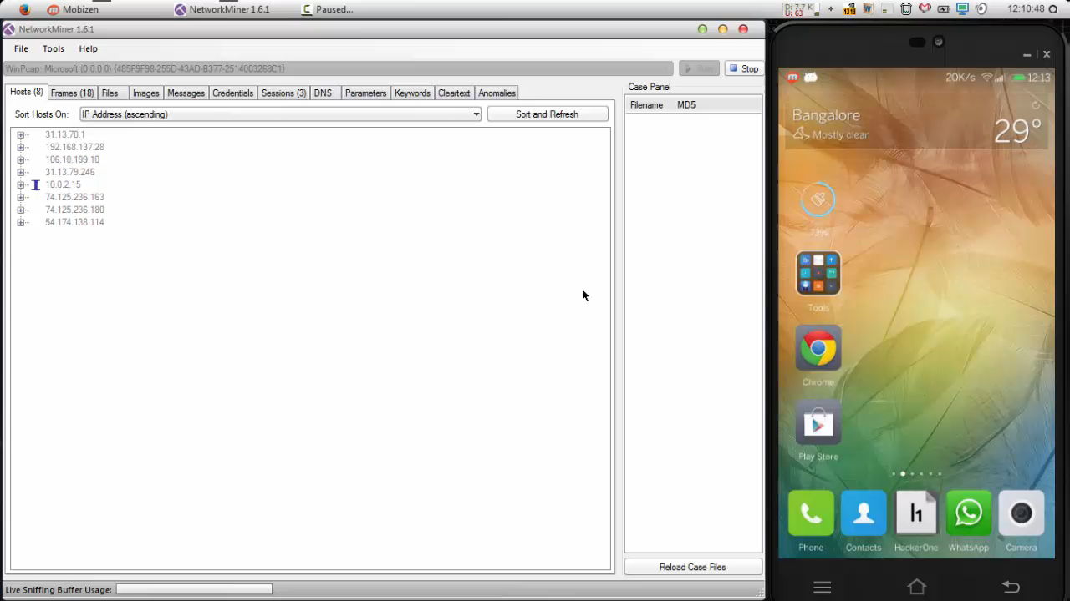
0x08 Insecure transmission of data
Nothing much to explain : use HTTPS everywhere
Found in iOS and Android both
$140* 2 = $280

Slide 19
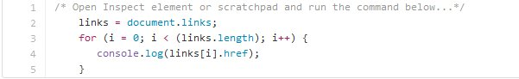
0x09 Complete Source code dump
What's the story?
Started with finding subdomains:
Subbrute
Virustotal.com
Dnsdumster.com
Dnsdb.org
Censys.io
CSP headers
Links in the webpage
Any suggestions?

Slide 20
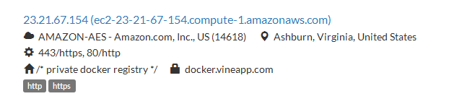
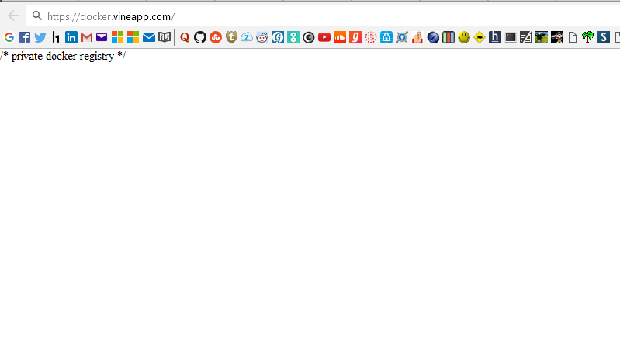
0x09 Complete Source code dump
Censys result :
When trying to access the domain :

Slide 21
0x09 Complete Source code dump
Need to understand “Docker registry api”
https://docs.docker.com/registry/spec/api/
But nothing works ☹
More effort is needed…
Docker has two versions of repository
V1 & V2
V1 doesn’t need any kind of authentication
V2 (latest one) its mandatory to authenticate first
Twitter’s vine app was using V1

Slide 22
0x09 Complete Source code dump
https://docker.vineapp.com/v1/search?q=vine&page=1&n=25
---Snip---
{
"num_results":82,
"query":"",
"results":
{
"description":null,
"name":"vine/baseimage"
},
{
"description":null,
"name":"vine/luigid"
},
---Snip---

Slide 23
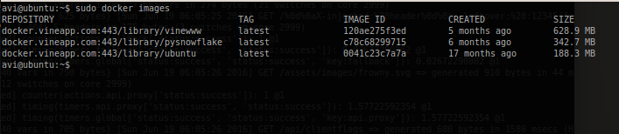
0x09 Complete Source code dump
Downloading the docker images:
Ubuntu64 + docker
$ docker pull docker.vineapp.com:443/latest/vinewww
….
$ docker images
$ 10080

Slide 24
0x09 Complete Source code dump
Show time ☺

Slide 25
0x0A … next time ☺
Times up ..
धन्यवाद
☻

